Slide 1
MODERN Youth problems
And how do we overcome them

Slide 2
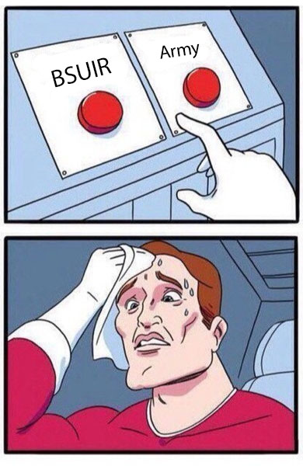
1. DECISION MAKING
So many crossings in life
No understanding, yet need to make it through

Slide 3
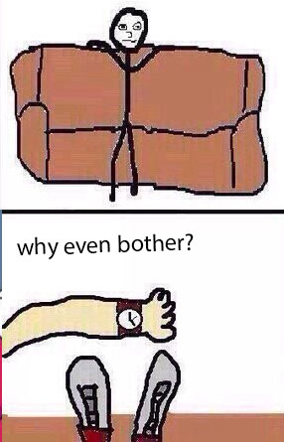
2. TIME MANAGEMENT
Lack of motivation
Volatile life
Lots of activities to switch between

Slide 4
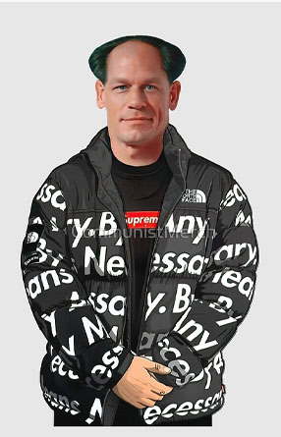
3. MATERIALISM
Hit to the parents’ wallet
Distorted perception of life
Not a diagnosed, but a serious problem

Slide 5
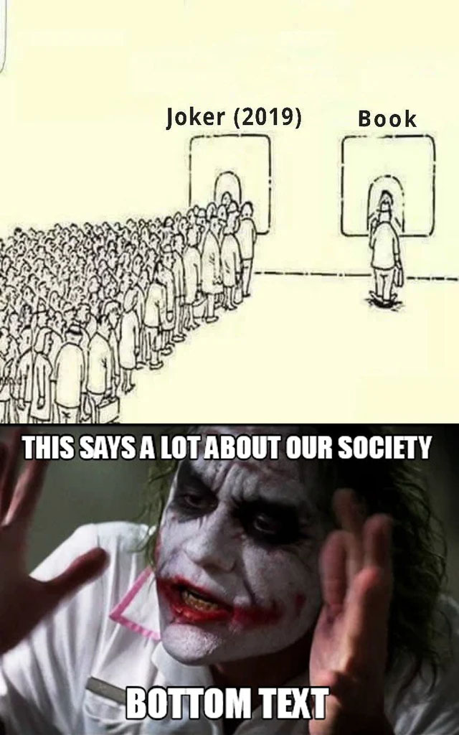
4. MEDIA OVERUSAGE
Another type of addictive and destructive behavior
Negative impact on lifestyle
Destruction of communicative skills

Slide 6
Thanks for attention!

